Slide 1



ZENLISH – HỌC TOEIC 1 LẦN LÀ ĐẠT
BEGINNER’S TOEIC
LESSON 5

Slide 2
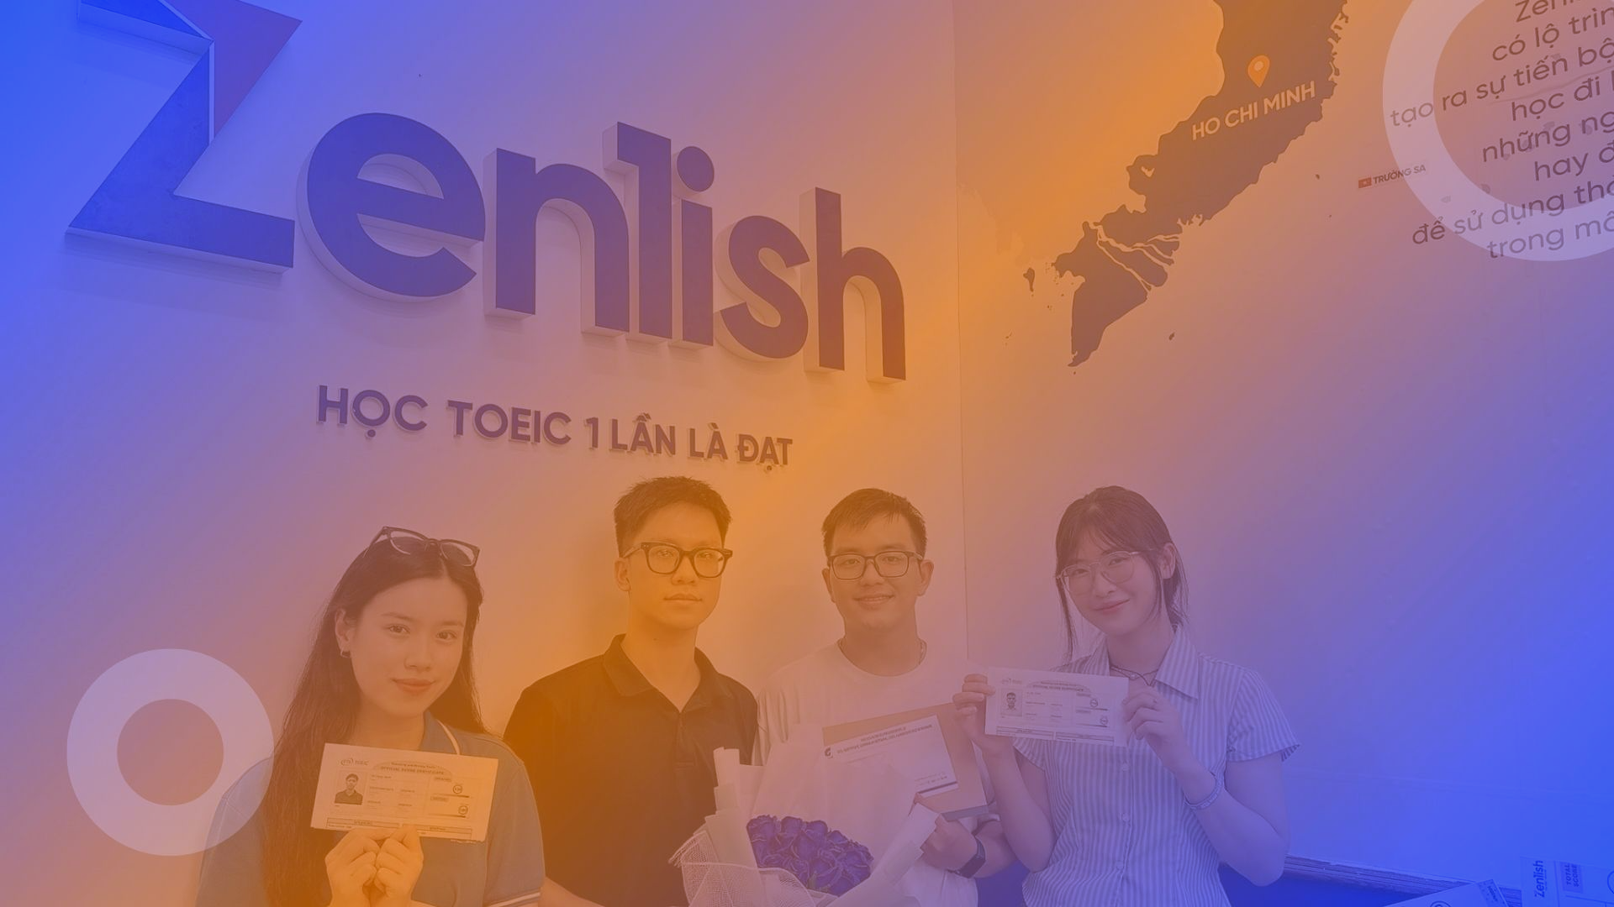


ZENLISH – HỌC TOEIC 1 LẦN LÀ ĐẠT
BEGINNER’S TOEIC
LESSON 5
CÂU HỎI ĐUÔI, TRẦN THUẬT

Slide 3



NỘI DUNG BÀI HỌC
1
Ví dụ
Từ vựng
3
2
Lý thuyết
Thực hành
4

Slide 4


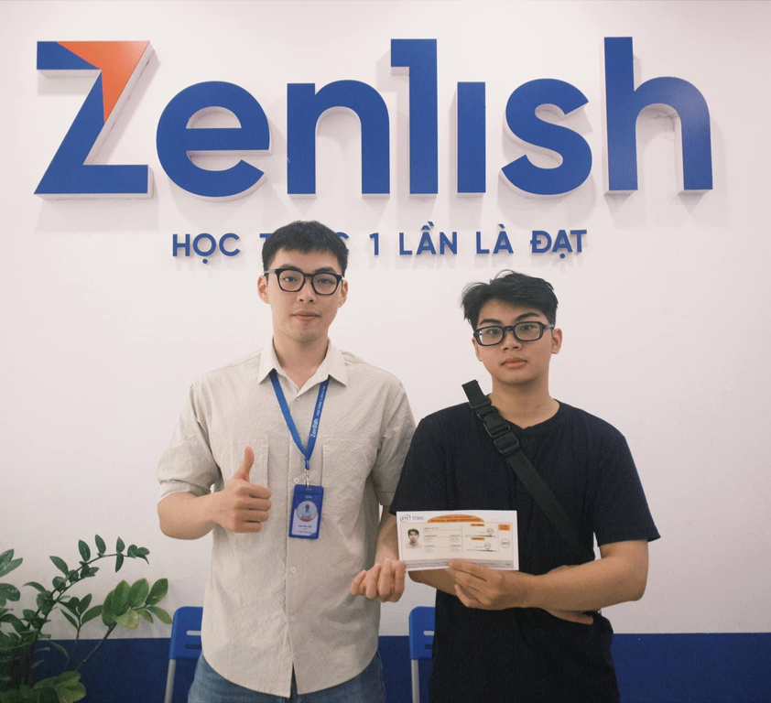


ZENLISH – HỌC TOEIC 1 LẦN LÀ ĐẠT
TOEIC LISTENING
PART 2 – TAG QUESTION

Slide 5
NỘI DUNG BÀI HỌC
1
Ví dụ

Slide 6
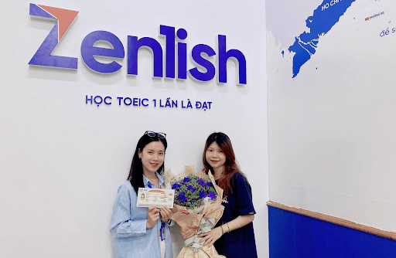

1
I’ll be sharing this office, won’t I?
I’ll be sharing this office, won’t I?
A. I think Sue’s the committee chair
B. Yes, your desk is by the window
B. Yes, your desk is by the window
Lưu ý:
Ở câu hỏi: Lắng nghe cụm từ quan trọng ở đầu hoặc giữa câu.
Ở đáp án đúng: Dựa vào cụm từ quan trọng ở câu hỏi để trả lời.
Lesson 1

Slide 7
2
Tomorrow is the deadline for this project, isn’t it?
Tomorrow is the deadline for this project, isn’t it?
A. Yes, Mr, Doyle wants it done by noon.
A. Yes, Mr, Doyle wants it done by noon.
B. The line’s over there.
Lưu ý:
Ở câu hỏi: Lắng nghe cụm từ quan trọng ở đầu hoặc giữa câu.
Ở đáp án đúng: Dựa vào cụm từ quan trọng ở câu hỏi để trả lời.
Lesson 1

Slide 8
3
You’re going to accept the supervisory position, aren’t you?
You’re going to accept the supervisory position, aren’t you?
A. I’m seriously considering it.
A. I’m seriously considering it.
B. The department head.
Lưu ý:
Ở câu hỏi: Lắng nghe cụm từ quan trọng ở đầu hoặc giữa câu.
Ở đáp án đúng: Dựa vào cụm từ quan trọng ở câu hỏi để trả lời.
Lesson 1

Slide 9
4
You read the final report, didn’t you?
You read the final report, didn’t you?
A. I just glanced at it.
A. I just glanced at it
B. I have to report to work on Monday.
Lưu ý:
Ở câu hỏi: Lắng nghe cụm từ quan trọng ở đầu hoặc giữa câu.
Ở đáp án đúng: Dựa vào cụm từ quan trọng ở câu hỏi để trả lời.
Lesson 1

Slide 10
NỘI DUNG BÀI HỌC
2
Lý thuyết

Slide 11
S + V + O, đuôi?
S + V + O, right?
Dựa vào N/V trong câu hỏi
Yes/No + vế giải thích
Động từ đi kèm

Slide 12
NỘI DUNG BÀI HỌC
3
Từ vựng

Slide 13
TỪ VỰNG
The bank opens at 9, doesn’t it? – I’m sure it does. Tim is leading the training, right? – Yes, that’s what I heard. I can leave my bag here, can’t I? – Of course you can. You finished the report, didn’t you? – No, I’ll do it tonight. You’ve sent the invoice, haven’t you? – No, not yet. / No, John did. Ms. Shin is in the office, isn’t she? – No, she’s on vacation This is the last interview, isn’t it? – No, there’s one more. There are folders in the supply room, right? – No, I used the last one.

Slide 14
NỘI DUNG BÀI HỌC
4
Thực hành

Slide 15
ZENLISH – HỌC TOEIC 1 LẦN LÀ ĐẠT
BEGINNER’S TOEIC
LESSON 5
TAG QUESTION - TEST TACTIC

Slide 16


1
You’ve operated this equipment before, haven’t you?
You’ve operated this equipment before, haven’t you?
A. Yes, many times
B. In the training manual
C. No, the factory

Slide 17
2
Mr. Chang will receive a raise, won’t he?
Mr. Chang will receive a raise, won’t he?
A. Yes, he worked really hard this year
B. No, I got it for my birthday
C. I’ll pay him a visit soon

Slide 18
ZENLISH – HỌC TOEIC 1 LẦN LÀ ĐẠT
TOEIC LISTENING
PART 2 – STATEMENT

Slide 19
NỘI DUNG BÀI HỌC
1
Ví dụ

Slide 20
1
They won’t bill us for their consulting service.
They won’t bill us for their consulting service.
A. Yes, I saw their advertisement
A. Yes, I saw their advertisement
B. I have change for a 10 dollar bill
Lưu ý:
Trong câu hỏi: Dựa vào 4 từ đầu tiên, để phán đoán ý nghĩa ngầm hiểu là “thông báo 1 nội dung mới”
Trong đáp án: Xác nhận theo nghĩa ngầm hiểu đó.
Lesson 1

Slide 21
2
I thought the workshop was very useful.
I thought the workshop was very useful.
A. It’s new, not used
B. Yes. I learned a lot
Lưu ý:
Trong câu hỏi: Dựa vào 4 từ đầu tiên, để phán đoán ý nghĩa ngầm hiểu là “tìm kiếm sự tán đồng”
Trong đáp án: Xác nhận theo nghĩa ngầm hiểu đó.
Lesson 1

Slide 22
3
Let’s buy our tickets now in case the show sells out.
Let’s buy our tickets now in case the show sells out.
A. That’s probably a good idea
A. That’s probably a good idea
B. Yes, everything was half off
Lưu ý:
Trong câu hỏi: Dựa vào 4 từ đầu tiên, để phán đoán ý nghĩa ngầm hiểu là “yêu cầu/ đề nghị 1 việc làm”
Trong đáp án: Xác nhận theo nghĩa ngầm hiểu đó.
Lesson 1

Slide 23
4
I can’t make it to the party tonight.
I can’t make it to the party tonight.
A. Do you have other plans?
A. Do you have other plans?
B. She will come, too
Lưu ý:
Trong câu hỏi: Dựa vào 4 từ đầu tiên, để phán đoán ý nghĩa ngầm hiểu là “thông báo 1 nội dung mới”
Trong đáp án: Xác nhận theo nghĩa ngầm hiểu đó.
Lesson 1

Slide 24
NỘI DUNG BÀI HỌC
2
Lý thuyết

Slide 25
CÁCH NHẬN DIỆN CÂU HỎI
4 từ đầu tiên
Thông báo nội dung mới
Tìm kiếm sự tán đồng
Yêu cầu/ đề nghị

Slide 26
CÁCH NHẬN DIỆN ĐÁP ÁN ĐÚNG
Cụm từ cảm thán diễn tả sự đồng ý
Câu trần thuật
Cụm từ nêu cảm nhận cá nhân
Câu hỏi ngược lại

Slide 27
NỘI DUNG BÀI HỌC
3
Từ vựng

Slide 28
TỪ VỰNG
I can’t open the file. The copier is broken. I’m afraid I won’t join you. I’m having trouble doing A. We’re out of flyers. We need to buy a new blender. | Sorry, I’ll try sending it again. Call the technician. I’m sorry to hear that. I can help you with that. There’s a printer in my office. That’s a good idea.

Slide 29
TỪ VỰNG
We should call off the meeting. We’re going out for dinner tonight. The deadline is on Monday. Our online business is growing faster this year. Our sales are low. | I agree with you. That sounds nice. Where did you hear that? It really is. I’ll look at the results again.

Slide 30
NỘI DUNG BÀI HỌC
4
Thực hành

Slide 31
ZENLISH – HỌC TOEIC 1 LẦN LÀ ĐẠT
BEGINNER’S TOEIC
LESSON 5
STATEMENT - TEST TACTIC

Slide 32
1
The chair in my office is very uncomfortable.
The chair in my office is very uncomfortable.
A. Let me find you another one
B. It’s a difficult decision
C. There’s room for six at the table

Slide 33
2
Please read this manual before tomorrow’s training session.
Please read this manual before tomorrow’s training session.
A. I’ll be sure to look it over
B. It’s a new transmission
C. I saw him at the station

Slide 34
ZENLISH – HỌC TOEIC 1 LẦN LÀ ĐẠT
BEGINNER’S TOEIC
LESSON 5
ACTUAL TEST

Slide 35
1
I’m looking for an inexpensive DVD player
I’m looking for an inexpensive DVD player
A. As likely as possible
B. He plays as well
C. Let’s see what is available

Slide 36
2
You made extra copies of the agenda, didn’t you?
You made extra copies of the agenda, didn’t you?
A. Oh, but I forgot to bring them
B. Thanks for doing that
C. No, the exit’s is on the left

Slide 37
3
Let's discuss the building designs this morning.
Let's discuss the building designs this morning.
A. We can do it this afternoon instead.
B. The sign on the wall.
C. Does he work in that building, too?

Slide 38
4
I wonder if the client has arrived to the airport
I wonder if the client has arrived to the airport
A. Let me check
B. Yes, that is wonderful
C. No, the hotel is nearby

Slide 39
5
We’ve just ordered several new fax machines, haven’t we?
We’ve just ordered several new fax machines, haven’t we?
A. Yes, we should get them tomorrow.
B. They should be in alphabet order
C. The facts are reported were correct

Slide 40
6
The registration deadline is on Friday.
The registration deadline is on Friday.
A. Where did you hear that?
B. They arrived already.
C. Yes, I'd like to.

Slide 41
7
We need a bigger hall for the banquet.
We need a bigger hall for the banquet.
A. There is a big hole in the ground
B. No, we have to import more
C. Mike is looking into it

Slide 42
8
The workshop’s been canceled, hasn’t it?
The workshop’s been canceled, hasn’t it?
A. It is about managing your time
B. No, it has just been postponed
C. It was a very nice shop

Slide 43
9
I can't seem to open the file you sent me.
I can't seem to open the file you sent me.
A. Yes, the post office is still open.
B. Sorry-I'll try sending it again.
C. We can't see that far either.

Slide 44
10
We’ll be having our photos taken at 4 pm
We’ll be having our photos taken at 4 pm
A. Yes, I have
B. I arrived late
C. I can’t be there then

Slide 45
11
The lights will be replaced, won’t they?
The lights will be replaced, won’t they?
A. A lighter workload
B. The supply cabinet
C. Yes, I’ll take care of it

Slide 46
12
I really need the updated expense report.
I really need the updated expense report.
A. The trip to London.
B. It wasn't that expensive.
C. I'll send it as soon as possible.

Slide 47
13
I need the complete inventory by 5 today.
I need the complete inventory by 5 today.
A. No, I only have 2
B. That shouldn’t be a problem
C. I finished reading that story

Slide 48
14
That building is still under construction, isn’t it?
That building is still under construction, isn’t it?
A. Maybe the site manager
B. Yes, It’s due to be finished in October
C. Yes, it is on level 6

Slide 49
15
The dinner with the clients is Wednesday.
The dinner with the clients is Wednesday.
A. Four copies, please.
B. I'm sure that he did.
C. That's not what I was told.

Slide 50
16
I'm going to put on my sweater.
I'm going to put on my sweater.
A. The morning weather report.
B. I could turn the heat up.
C. I haven't decided yet.

Slide 51
17
The play opens next week, doesn’t it?
The play opens next week, doesn’t it?
A. It starts on Thursday
B. In the back row
C. Why don’t you leave it open

Slide 52
18
This e-mail from Mr. Robertson is rather unclear.
This e-mail from Mr. Robertson is rather unclear.
A. Yesterday afternoon.
B. I didn't understand it either.
C. At the post office downtown.

Slide 53
19
I just received the weekly marketing report.
I just received the weekly marketing report.
A. I prefer the supermarket on North Street.
B. The market data was quite surprising.
C. He's away on business.

Slide 54
20
Can you call me back before 5 pm?
Can you call me back before 5 pm?
A. Yes, no problem
B. There are only 4
C. It’s in the back

Slide 55
21
The table should be set before the guests arrive.
The table should be set before the guests arrive.
A. No, twelve people at seven o'clock.
B. How was the party?
C. I'll do it right now.

Slide 56
22
Would you like another cup of coffee?
Would you like another cup of coffee?
A. It is 1$ per cup
B. I have been coughing all day
C. Thank you, it is delicious

Slide 57
23
Could you give me a ride to the airport?
Could you give me a ride to the airport?
A. No, I didn’t give him any.
B. Sure, what time is your flight?
C. About 20 minutes

Slide 58
24
I'd like you to present your proposal at the next council meeting.
I'd like you to present your proposal at the next council meeting.
A. Thank you for the nice present.
B. Sure, I'd be happy to.
C. Yes, it was an interesting meeting.

Slide 59
25
Would you like me to pick you up after work?
Would you like me to pick you up after work?
A. It’s too heavy.
B. You can pick whatever you like
C. No, I will be working late tonight

Slide 60
THANK YOU

